Slide 1
DSE 6220
Big Data
Hadoop & Spark
Week 3

Slide 2

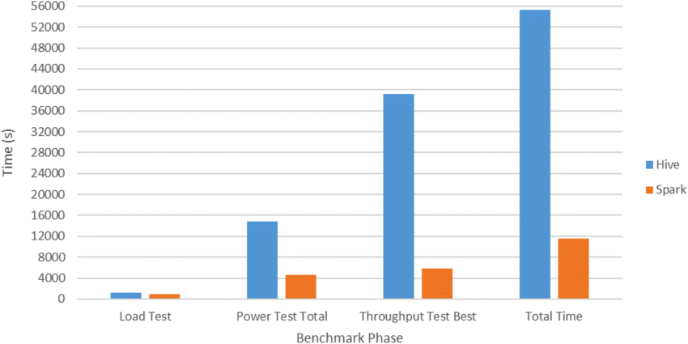
What is Spark?
Apache Spark is a multi-language engine for executing data engineering, data science, and machine learning on single-node machines or clusters.
It utilizes in-memory caching, and optimized query execution for fast analytic queries against data of any size.
Spark SQL adapts the execution plan at runtime, such as automatically setting the number of reducers and join algorithms.
Spark SQL works on structured tables and unstructured data such as JSON or images.
Speed
Ease of Use
Modularity
Extensibility

Slide 3
Overcoming Hadoop Limitations
Limitations
Overcoming the Limitations, Spark!
Hadoop is I/O Bound
Due to the nature of Hadoop and map-reduce any operation on data required accessing and manipulating data on disk.
Configuring Hadoop to run efficiently in this paradigm required an immense amount of expertise
ML was not an option due to the I/O limitation
MapReduce
Problems had to be expressed as key-value pairs so that each pair could be independently computed
Coding map-reduce in Java is non-trivial
Non-MapReduce use cases
Filters, joins, and other simple data operations would have to be expressed in map reduce which led to significant programming efforts
Programming APIs
Java was at the core of map reduce thus developers had to have a strong knowledge of the language including: garbage collection, the JVM, and other Java
I/O Bound Operations
Spark can store and access data in memory (RAM) which is 1000+ times faster than reading data from disk.
Solid State Drives (SSDs)
MapReduce
Spark does not require the use of MR thus the Java programming paradigm can be eliminated.
Helpful for more use cases such as ML
Non-MR Use Cases
Spark SQL & Spark Streaming provide a rich set of functionalities that allow users to perform common SQL tasks without having to write complex Java.
Programming APIs
Spark supports many programming APIs outside of Java such as Python, Scala, and R which makes Hadoop immediately accessible to a large community of developers.

Slide 4
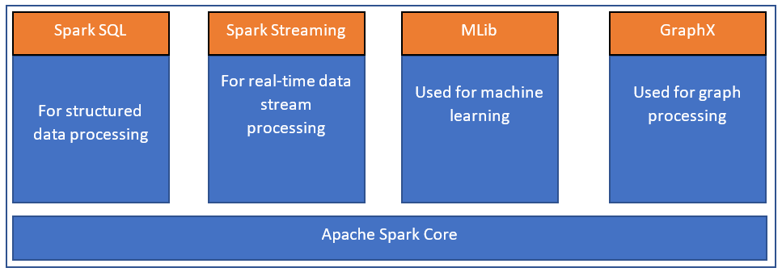
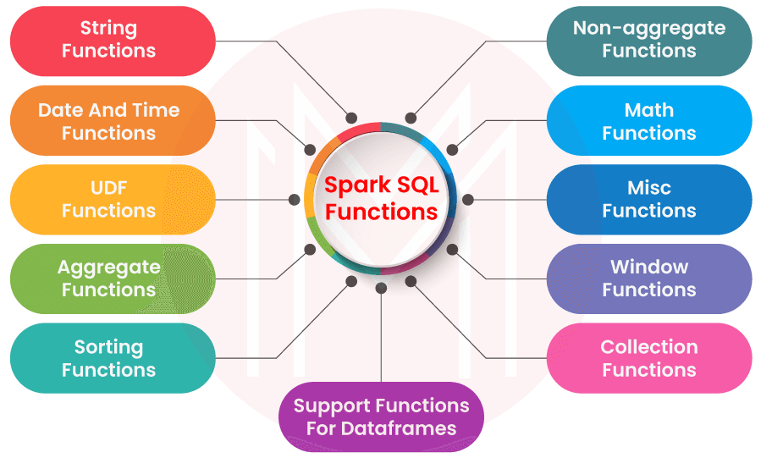
Spark Core Components (libraries)
Spark Core
Spark’s fundamental components such as the RDD concept.
Task schedulers, memory management, fault recovery, interacting with storage systems.
Spark SQL
Provides ability to query data stored in Apache Hive, Parquet, and JSON.
Provides developers a SQL interface to interacting with Spark.
Spark Streaming
Provides an interface to interact with streaming sources such as Kafka.
GraphX
Provides an interface for working with graph databases and datasets that utilize these specialized structures
MLLib
Scalable framework for machine learning
Classification, regression, clustering, recommendation, topic model, etc
MLOps

Slide 5
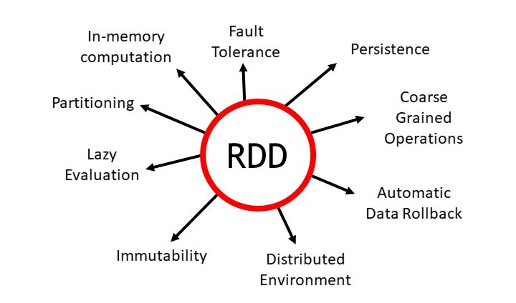
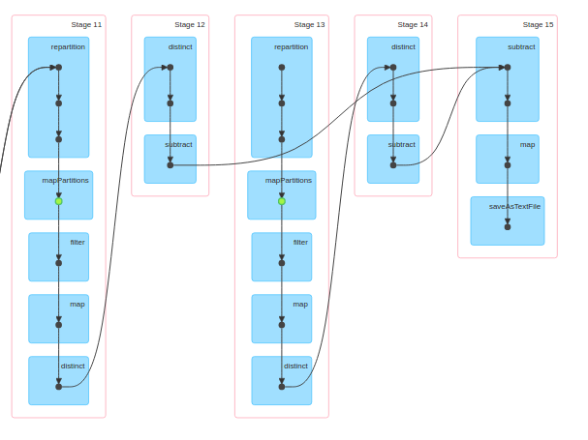
Important Spark Concepts
Resilient Distributed Datasets (RDDs)
Sparks primary data structure.
Collection of records that are stored across a Spark cluster
Immutable
Native parallel support
Directed Acyclic Graphs
DAGs help Spark to build a workflow for each job
Essentially a flowchart that creates a series of steps to complete a job
Provides a mechanism for spark to track the dependencies of each job

Slide 6
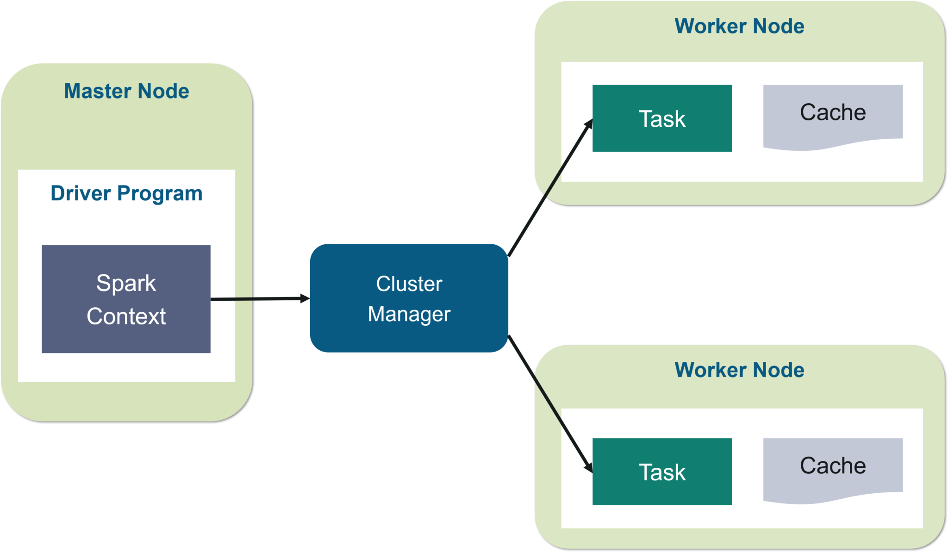
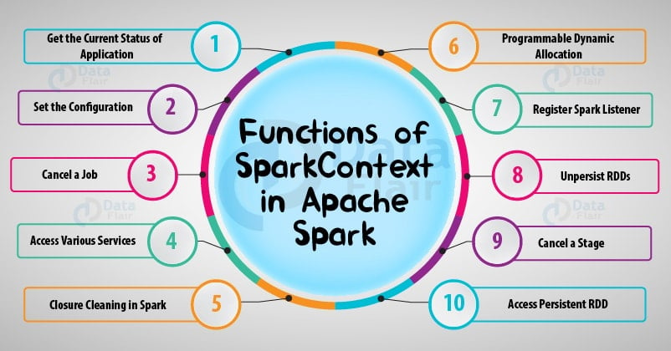
Important Spark Concepts
SparkContext
Means in which the application connects to the resources of the Spark cluster
Creates the job, assigns the resources, performs the actions, and creates the RDDs
Newer versions of Spark use SparkSession which is a superset of SparkContext.
This is the ‘driver’
Where you set all of your resources and the ‘configuration’ of your cluster.

Slide 7
Important Spark Concepts
Spark DataFrames
Higher level of abstraction on RDDs where data is stored into rows and columns.
A more familiar API for working with tabular data.
Actions and Transformations (lazy evaluation)
Transformations
Specify operations such as filters, joins, aggregation but DO NOT return data
Actions
Return the transformations laid out in the transformations stage
Transformations & actions ALWAYs produce new RDDs
Spark optimizes your query using a DAG before it is executed.
Spark Deployment Options
Standalone
Amazon EC2 or EMR
Apache Yarn
Kubernetes
Cluster Manager
Similar to the resource manager in Hadoop
Worker Nodes
The servers where Spark

Slide 8
Who uses Spark?
Data Scientists
Data Engineers
Goal is to analyze data and extract insights.
Use interactive programming to perform ad-hoc analysis.
Spark-shell and notebook capabilities allow Spark to be easily used by this group of people.
The folks who build production grade applications or ETLs.
Often, they will build compiled Spark applications and deploy them on their cluster.
The modular framework of the API makes it easy for these individuals to utilize OOD (object oriented design) principles to build applications.

Slide 9
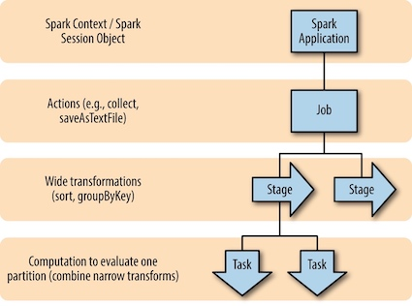
Spark Application Concepts
Application
A user program built on Spark using its APIs. It consists of a driver program and executors on the cluster.
SparkSession
An object that provides a point of entry to interact with underlying Spark functionality and allows programming Spark with its APIs. In an interactive Spark shell, the Spark driver instantiates a SparkSession for you, while in a Spark application, you create a SparkSession object yourself.
Job
A parallel computation consisting of multiple tasks that gets spawned in response to a Spark action. (collect)
Stage
Each job gets divided into smaller sets of tasks called stages that depend on each other.
Task
A single unit of work that will be sent to a Spark executor.

Slide 10
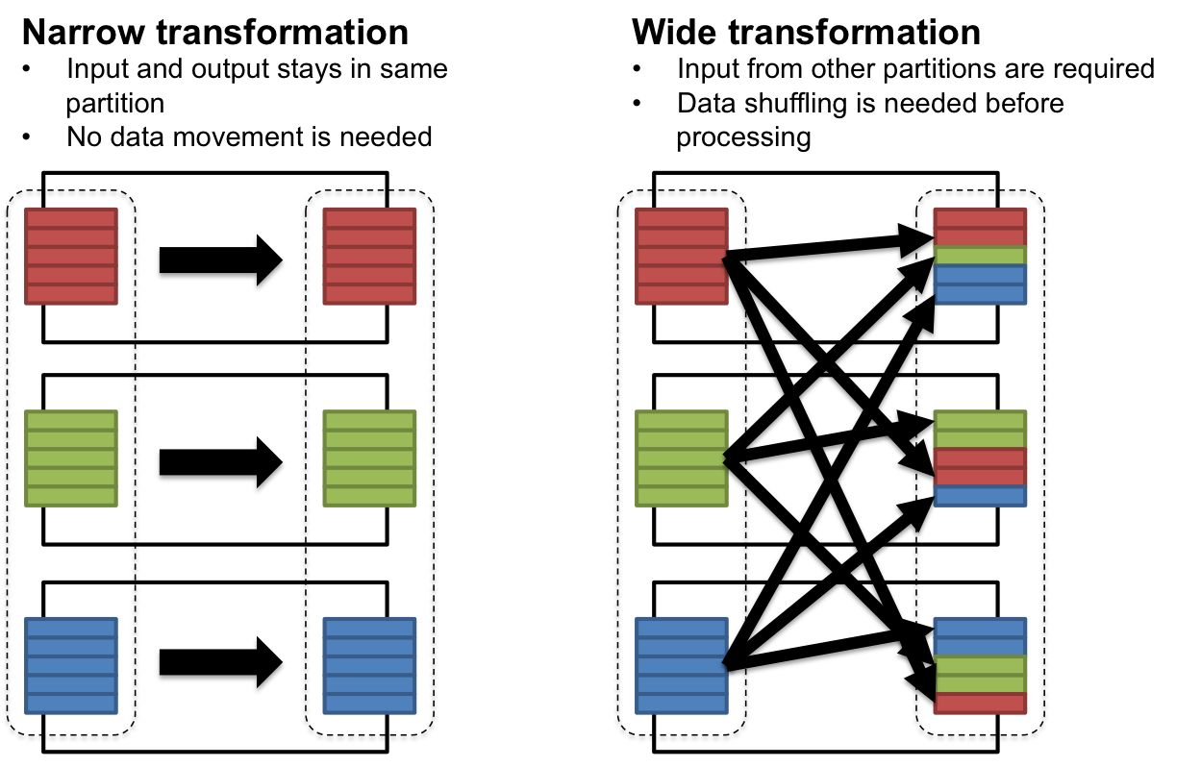

Slide 11
Installing Spark (Lab)

Slide 12
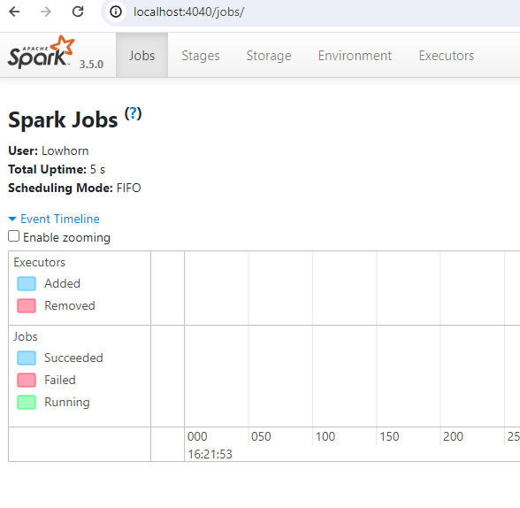
Spark UI

Slide 13
Environment Variables
Windows
Mac
https://www.howtogeek.com/787217/how-to-edit-environment-variables-on-windows-10-or-11/
Identical to Linux systems
https://phoenixnap.com/kb/set-environment-variable-mac

